Slide 1
CS445 NPM Package Modeling
Matthew MacNeil

Slide 2
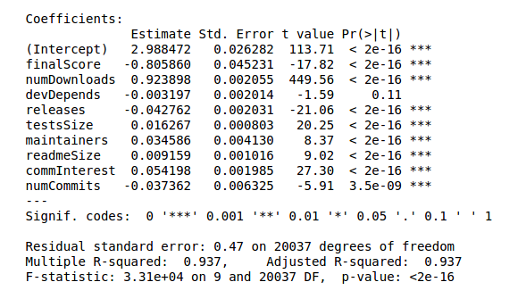
Selection/Linear Regression
PCA:
finalScore
numDownloads
releases
testsSize
Regression
commInterest
numCommits

Slide 3
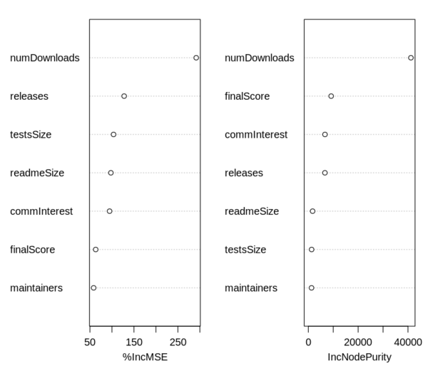
Random Forest
Number of downloads has biggest impact on both MSE and IncNodePurity
Random Forest model much more able to predict number of downloads than the linear model

